Slide 1
NORMALIZATION
In relational database design, we not only want to create a
structure that stores all of the data, but we also want to
do it in a way that minimize potential errors when we
work with the data.
The default language for accessing data from a relational
database is SQL.
In particular, SQL can be used to manipulate data in the
following ways:
insert new data,
delete unwanted data,
update existing data.
Similarly, in an un-normalized design, there are 3
problems that can occur when we work with the data:

Slide 2
Anomalies
INSERT ANOMALY:
This refers to the situation when it is impossible to insert certain types of data into the database.
DELETE ANOMALY:
The deletion of data leads to unintended loss of additional data, data that we had wished to preserve.
UPDATE ANOMALY:
This refers to the situation where updating the value of a column leads to database inconsistencies (i.e., different rows on the table have different values).

Slide 3
Normal Forms
To address the 3 problems above, we go through the process of normalization. When we go through the normalization process, we increase the number of tables in the database, while decreasing the amount of data stored in each table. There are several different levels of database normalization:
1st Normal Form (1NF)
2nd Normal Form (2NF)
3rd Normal Form (3NF)
Bryce-Codd Normal Form (BCNF)
4th Normal Form (4NF)
5th Normal Form (5NF)
The opposite of normalization is denormalization, where we want to combine multiple tables together into a larger table. Denormalization is most frequently associated with designing the fact table in a data warehouse.

Slide 4
1st Normal Form Definition
A database is in first normal form if it satisfies the following conditions:
Contains only atomic values
There are no repeating groups
An atomic value is a value that cannot be divided. For example, in the table shown below, the values in the [Color] column in the first row can be divided into "red" and "green", hence [TABLE_PRODUCT] is not in 1NF.
A repeating group means that a table contains two or more columns that are closely related. For example, a table that records data on a book and its author(s) with the following columns: [Book ID], [Author 1], [Author 2], [Author 3] is not in 1NF because [Author 1], [Author 2], and [Author 3] are all repeating the same attribute.

Slide 5
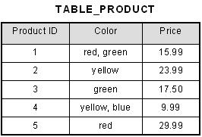
1st Normal Form Definition
Example
How do we bring an unnormalized table into first normal form? Consider the following example:
This table is not in first normal form because the [Color] column can contain multiple values. For example, the first row includes values "red" and "green."

Slide 6
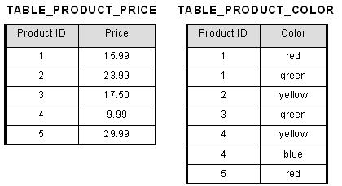
1st Normal Form Definition
To bring this table to first normal form, we split the table into two tables and now we have the resulting tables:

Slide 7
2nd Normal Form Definition
A database is in second normal form if it satisfies the following conditions:
It is in first normal form
All non-key attributes are fully functional dependent on the primary key
In a table, if attribute B is functionally dependent on A, but is not functionally dependent on a proper subset of A, then B is considered fully functional dependent on A.
Hence, in a 2NF table, all non-key attributes cannot be dependent on a subset of the primary key. Note that if the primary key is not a composite key, all non-key attributes are always fully functional dependent on the primary key.
A table that is in 1st normal form and contains only a single key as the primary key is automatically in 2nd normal form.

Slide 8
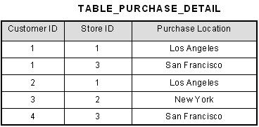
2nd Normal Form Definition
Example
This table has a composite primary key [Customer ID, Store ID]. The non-key attribute is [Purchase Location]. In this case, [Purchase Location] only depends on [Store ID], which is only part of the primary key. Therefore, this table does not satisfy second normal form.

Slide 9
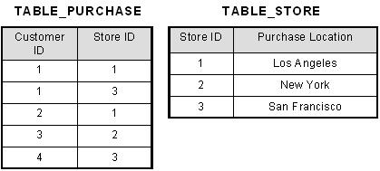
2nd Normal Form Definition
To bring this table to second normal form, we break the table into two tables, and now we have the following:
What we have done is to remove the partial functional dependency that we initially had. Now, in the table [TABLE_STORE], the column [Purchase Location] is fully dependent on the primary key of that table, which is [Store ID].

Slide 10
3rd Normal Form Definition
A database is in third normal form if it satisfies the following conditions:
It is in second normal form
There is no transitive functional dependency
By transitive functional dependency, we mean we have the following relationships in the table: A is functionally dependent on B, and B is functionally dependent on C. In this case, C is transitively dependent on A via B.

Slide 11
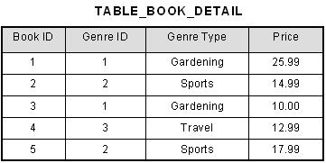
3rd Normal Form Definition
Example
In the table able, [Book ID] determines [Genre ID], and [Genre ID] determines [Genre Type]. Therefore, [Book ID] determines [Genre Type] via [Genre ID] and we have transitive functional dependency, and this structure does not satisfy third normal form.

Slide 12
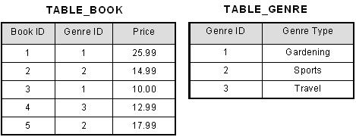
3rd Normal Form Definition
To bring this table to third normal form, we split the table into two as follows:
Now all non-key attributes are fully functional dependent only on the primary key.
In [TABLE_BOOK], both [Genre ID] and [Price] are only dependent on [Book ID]. In [TABLE_GENRE], [Genre Type] is only dependent on [Genre ID].

Slide 13
The Boyce-Codd Normal Form
A relational schema R is considered to be in Boyce–Codd normal form (BCNF) if, for every one of its dependencies X → Y, one of the following conditions holds true:
X → Y is a trivial functional dependency (i.e., Y is a subset of X)
X is a superkey for schema R
Informally the Boyce-Codd normal form is expressed as “Each attribute must represent a fact about the key, the whole key, and nothing but the key.”

Slide 14
The Boyce-Codd Normal Form
Example
Let’s take a look at this table, with some typical data. The table is not in BCNF.
The nontrivial functional dependencies in the table are:
author → nationality
book title → genre, number of pages
We can easily see that the only key is the set {author, book title}.
Author | Nationality | Book title | Genre | No of pages
William Shakespeare | English | The Comedy of Errors | Comedy | 100
Markus Winand | Austrian | SQL Performance Explained | Textbook | 200
Jeffrey Ullman | American | A First Course in Database Systems | Textbook | 500
Jennifer Widom | American | A First Course in Database Systems | Textbook | 500

Slide 15
The Boyce-Codd Normal Form
The same data can be stored in a BCNF schema. However, this time we would need three tables.
Author | Nationality
William Shakespeare | English
Markus Winand | Austrian
Jeffrey Ullman | American
Jennifer Widom | American
Book title | Genre | No of Pages
The Comedy of Errors | Comedy | 100
SQL Performance Explained | Textbook | 200
A First Course in Database Systems | Textbook | 500
Author | Book title
William Shakespeare | The Comedy of Errors
Markus Winand | SQL Performance Explained
Jeffrey Ullman | A First Course in Database Systems
Jennifer Widom | A First Course in Database Systems

Slide 16
The Boyce-Codd Normal Form
The functional dependencies for this schema are the same as before:
author → nationality
book title → genre, number of pages
The key of the first table is {author}.
The key of the second table is {book title}.
The key of the third table is {author, book title}.
There are no functional dependencies violating the BCNF rules, so the schema is in Boyce-Codd normal form.

Slide 17
Fourth normal form (4NF):
Fourth normal form (4NF) is a level of database normalization where there are no non trivial multivalued dependencies other than a candidate key.
It builds on the first three normal forms (1NF, 2NF and 3NF) and the Boyce-Codd Normal Form (BCNF).
It states that, in addition to a database meeting the requirements of BCNF, it must not contain more than one multivalued dependency.
Properties – A relation R is in 4NF if and only if the following conditions are satisfied:
It should be in the Boyce-Codd Normal Form (BCNF).
The table should not have any Multi-valued Dependency.

Slide 18
Fourth normal form (4NF):
Consider the database table of a class which has two relations R1 contains student ID(SID) and student name (SNAME) and R2 contains course id(CID) and course name (CNAME).
Table – R1(SID, SNAME) Table – R2(CID, CNAME)
Table – R1 X R2
Multivalued dependencies (MVD) are:
SID->->CID; SID->->CNAME; SNAME->->CNAME
SID | SNAME
S1 | A
S2 | B
CID | CNAME
C1 | C
C2 | D
SID | SNAME | CID | CNAME
S1 | A | C1 | C
S1 | A | C2 | D
S2 | B | C1 | C
S2 | B | C2 | D

Slide 19
Fourth normal form (4NF):
Joint dependency
Join decomposition is a further generalization of Multivalued dependencies.
If the join of R1 and R2 over C is equal to relation R then we can say that a join dependency (JD) exists, where R1 and R2 are the decomposition R1(A, B, C) and R2(C, D) of a given relations R (A, B, C, D).

Slide 20
Fifth Normal Form / Projected Normal Form (5NF):
A relation R is in 5NF if and only if every join dependency in R is implied by the candidate keys of R. A relation decomposed into two relations must have loss-less join Property, which ensures that no spurious or extra tuples are generated, when relations are reunited through a natural join.
Properties – A relation R is in 5NF if and only if it satisfies following conditions:
R should be already in 4NF.
It cannot be further non loss decomposed (join dependency)

